Slide 1
Performance Comparison of PID, LQOC, PPC and MPC -CL686
By- Siddhant Chandel
Session 2023

Slide 2
AIM
To implement a Linear Quadratic Optimal Controller (LQOC) and Model Predictive Controller (MPC).
To simulate the the various control law (MPC, LQOC, PID, MPC) over a dynamic non linear system.
To compare the performance of the four controllers i.e. MPC,LQOC,PPC, PID by tabulating and plotting the results.
To perform the sensitivity analysis of MPC scheme by tuning the control horizon.

Slide 3
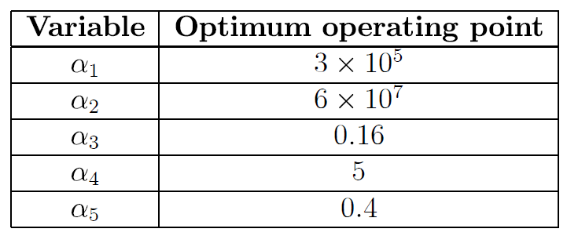


SYSTEM MODEL
$$\frac{dX_{1}}{dt}= −\frac{α_{3}U_{1}X_{1}}{X_{3}}+k_{1}\left(X_{2}\right)\left(D−X_{1}\right)−k_{2}\left(X_{2}\right)X_{1}$$
$$\frac{dX_{2}}{dt}=α_{3}U_{1}\left(U_{2}−X_{2}\right)+α_{4}[k_{1}\left(X_{2}\right)\left(D−X_{1}\right)−k_{2}\left(X_{2}\right)X_{1}]$$
$$\frac{dX_{3}}{dt}=α_{3}U_{1}−α_{5}\sqrt{X_{3}}$$
$$k_{1}\left(X_{2}\right)=α_{1}exp⁡(−\frac{5000}{X_{2}})$$
$$k_{2}\left(X_{2}\right)=α_{2}exp⁡(−\frac{7500}{X_{2}})$$
System state :
$X_{1}$ = Concentration of product
$X_{2}$= Temperature $X_{3}$= Liquid level
Manipulated Inputs:
$U_{1}$= Inlet flow rate
$U_{2}$= Inlet fluid Temperature
Steady states :
$X_{s}$= ${\left[\begin{matrix}0.40095 & 392 & 0.16\end{matrix}\right]}^{T}$
$U_{s}$=${\left[\begin{matrix}1 & 390\end{matrix}\right]}^{T}$
$D_{s}$= 1

Slide 4

DISCRETE MODELS
MPC
The augmented estimator which can be used to implement the MPC is as follows:
$$y\left(k\right)=Y\left(k\right)−Y_{s}$$
$$e\left(k\right)=y\left(k\right)−C\hat{x}\left(k\right)$$
$${\hat{x}}_{a}\left(k+1\right)=φ_{a}\hat{x}\left(k\right)+γ_{ua}u\left(k\right)+L_{a}e\left(k\right)$$
Where
$${\hat{x}}_{a}\left(k\right)=\left[{\hat{x}\left(k\right) \atop \hat{β}\left(k\right)}\right]$$
The steady state Kalman gain $L_{a}$, is obtained by solving the steady state Riccati equation using Matlab Toolbx function ‘kalman’.

Slide 5

LQOC
The ARX Model Identified from the data is used as an estimator as follows
$$y\left(k\right)=Y\left(k\right)−Ys$$
$$e\left(k\right)=y\left(k\right)−\tilde{C}\hat{z}\left(k\right)$$
$$\hat{z}= \tilde{φ}\hat{z}\left(k\right)+{\tilde{γ}}_{u}u\left(k\right)+Le(k)$$
The LQOC is implemented as follows :
$$u\left(k\right)=u_{s}\left(k\right)−G_{∞}\left[\hat{z}\left(k\right)−z_{s}\left(k\right)\right]$$
$$u_{L}≤u\left(k\right)≤u_{H}$$
The controller gain matrix $G_{∞}$ is obtained by solving the algebraic Riccati equation and thesolution for which can be found using Matlab Control system Toolbox function ‘dlqr’
$$G_{∞}=(W_{u}+{\tilde{γ}}^{T}S_{∞}{\tilde{γ}}^{−1}{\tilde{Y}}^{T}S_{∞}\tilde{φ}$$
$$S_{∞}={\left[\tilde{φ}−γG_{∞}\right]}^{T}S_{∞}\left[\tilde{φ}−γG_{∞}\right]+{\tilde{C}}^{T}W_{y}\tilde{C}+\tilde{G_{∞}}W_{u}G_{∞}$$

Slide 6


PPC
For a given state space model
$$x\left(k+1\right)=φx\left(k\right)+γu(k)$$
$$y\left(k\right)=Cx(k)$$
Computing innovations as
$$e\left(k\right)=y\left(k\right)−C\hat{x}(k)$$
The state estimator could be written as
$$\hat{x}\left(k+1\right)=φ\hat{x}\left(k\right)+γ_{u}u\left(k\right)+Le\left(k\right)$$
PID
A new state variable $η(t)$ is defined as $η\left(t\right)= \int_{0}^{t}{e(τ)}dτ$
Such that sequence of computation at kth sampling instant is
$$e\left(k\right)=r\left(k\right)−y(k)$$
$$η\left(k+1\right)=η\left(k\right)+Te(k)$$
$$u\left(k\right)=C_{c}η\left(k\right)+D_{c}e(k)$$
Controller pairing:
$$e_{1k}=r_{2k} −y_{2k}$$
$$e_{2k}=r_{1k}−y_{1k}$$
Constraints
$$U_{k}=U_{s}+u_{k}$$
$$U_{L}≤U_{k}≤U_{H}$$

Slide 7

Controller Tuning Parameters
Kalman Predictor Parameter (for State Augmentation Approach)
$$initial condition{(\hat{x}}_{a})={\left[0 0 0 0 0\right]}^{T} γ=\left(\frac{2}{3}\right) Q_{β}=γ\left[\begin{matrix}{0.001}^{2} & 0 \\ 0 & {0.05}^{2}\end{matrix}\right]$$
MPC Controller Tuning Parameters
$$p=40, q=5,η=0.4$$
$W_{x}=\left[\begin{matrix}{10}^{4} & 0 \\ 0 & 100\end{matrix}\right]$ $W_{y}=\left[\begin{matrix}1 & 0 \\ 0 & 100\end{matrix}\right]$ $W_{u}=0.4\left[\begin{matrix}1 & 0 \\ 0 & 10\end{matrix}\right]$ $W_{∆u}=0.4\left[\begin{matrix}5 & 0 \\ 0 & 5\end{matrix}\right]$
ARX Based LQG Parameters
$W_{y}=\left[\begin{matrix}1 & 0 \\ 0 & 100\end{matrix}\right]$ $W_{u}=0.4\left[\begin{matrix}1 & 0 \\ 0 & 10\end{matrix}\right]$
Innovation filter ($α$) = 0.9

Slide 8
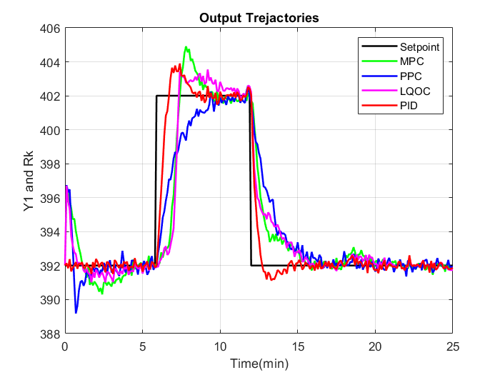
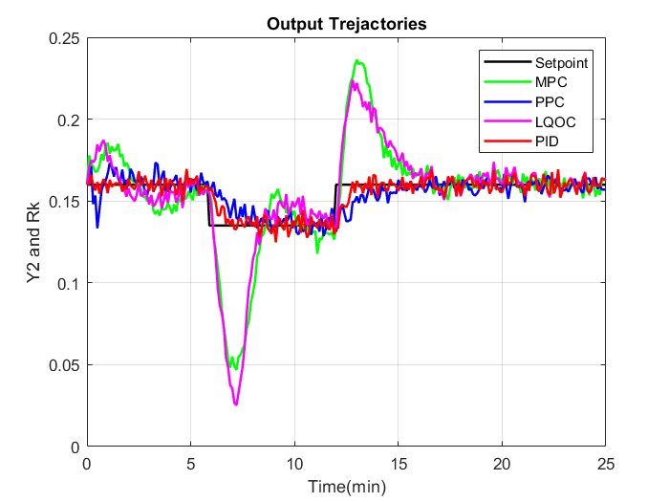


RESULTS
Plots for $Y_{i}\left(k\right) vs R_{i}(k)$
$$Y_{1}\left(k\right) vs R_{1}(k)$$
$$Y_{2}\left(k\right) vs R_{2}(k)$$

Slide 9
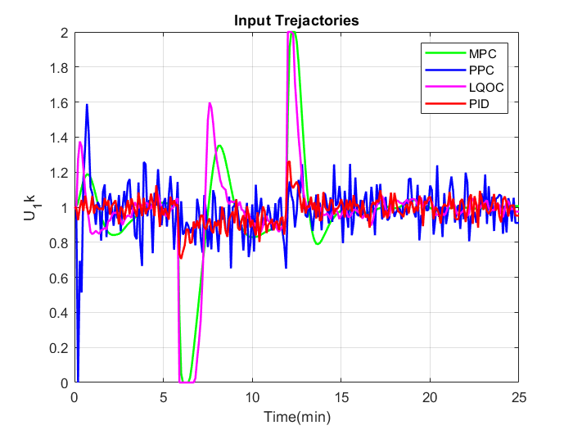
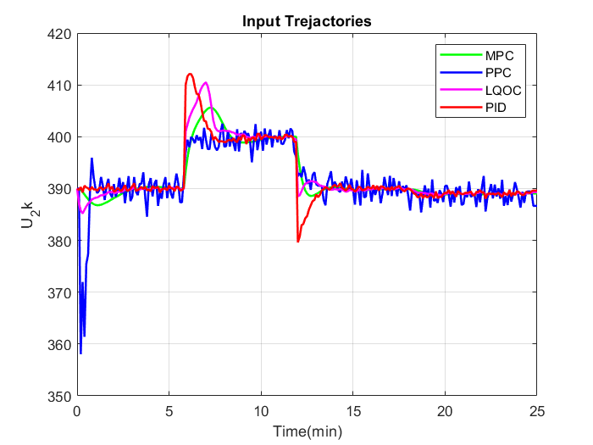



Plots for Manipulated Inputs $(U_{i}k)$)
$U_{1}\left(k\right)$ for four different controllers
$U_{2} \left(k\right)$ for four different controllers

Slide 10
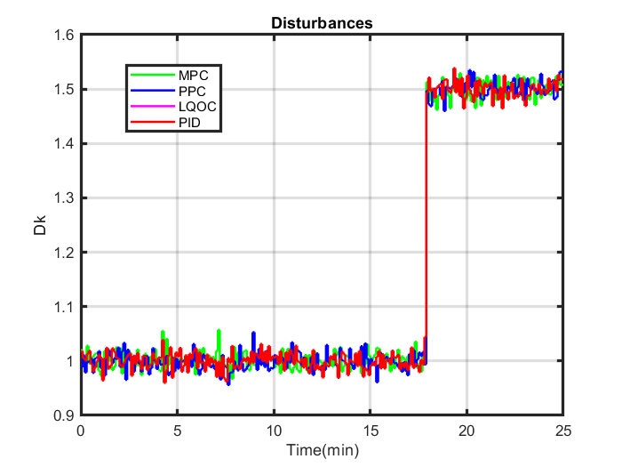


Plot for D$isturbances D(k)$
D$\left(k\right)$ for four different controllers

Slide 11


Performance Indices
Sum of Squared errors
$$SSE =\sum_{k=1}^{Ns}{{\left[Y_{i}\left(k\right)−R_{i}\left(k\right)\right]}^{2}}$$
Sum of squared manipulated variables
$$SSMV= \sum_{k=1}^{Ns}{{\left[U_{i}\left(k\right)−U_{s}\right]}^{2}}$$
$N_{s} =$ Length of sampling interval
$k =$Current time instant
$Y\left(k\right)=$Output at 𝑘
$R\left(k\right)=$ Set point given at 𝑘
$U\left(k\right)=$Manipulated input at 𝑘
$U_{s} =$Steady state value

Slide 12
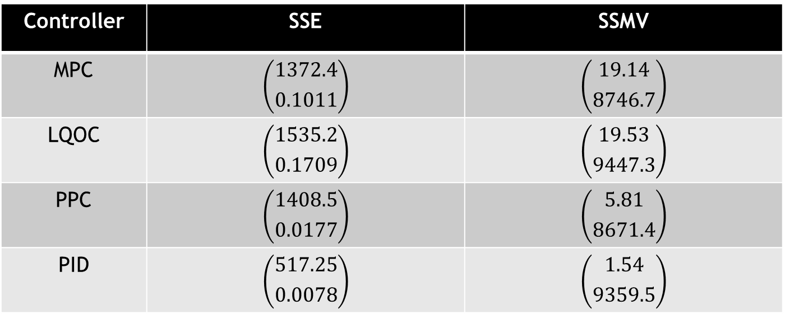
Performance Indices Comparison (SSE,SSMV)
Controller | SSE | SSMV
MPC | $$\left({1372.4 \atop 0.1011}\right)$$ | $$\left({19.14 \atop 8746.7}\right)$$
LQOC | $$\left({1535.2 \atop 0.1709}\right)$$ | $$\left({19.53 \atop 9447.3}\right)$$
PPC | $$\left({1408.5 \atop 0.0177}\right)$$ | $$\left({5.81 \atop 8671.4}\right)$$
PID | $$\left({517.25 \atop 0.0078}\right)$$ | $$\left({1.54 \atop 9359.5}\right)$$

Slide 13
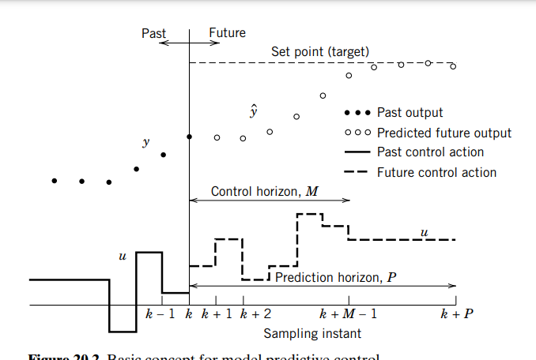
Sensitivity Analysis
The allotted controller tuning parameter is q, which is the length of control horizon. Sensitivity analysis of the MPC controller is performed by varying the value of q from 5 to the length of prediction horizon, p.
q = 5
p = 40
MPC is tuned and brought to the value q = p
Figure: Basic Concept of MPC
Source: Process Dynamics and Control by Seborg,2011

Slide 14
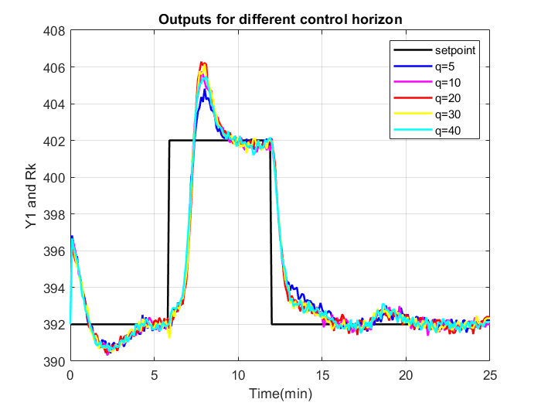
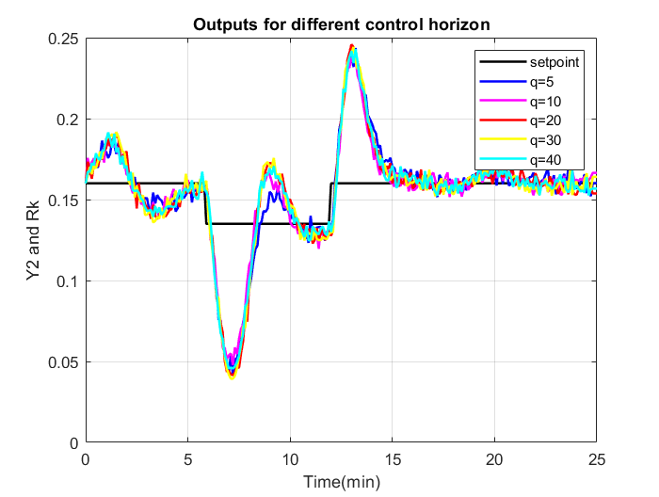


Plots for sensitivity analysis
Plots for $Y_{i}\left(k\right) vs R_{i}\left(k\right)$for different values of q
$$Y_{1}\left(k\right) vs R_{1}(k)$$
$$Y_{2}\left(k\right) vs R_{2}(k)$$

Slide 15
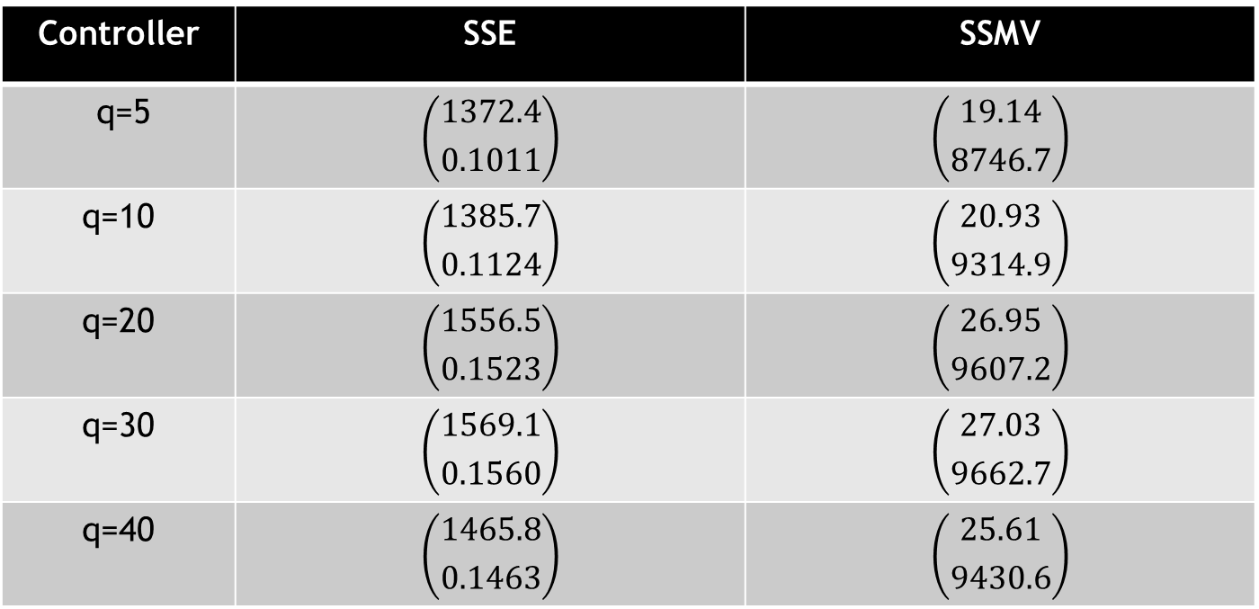
Performance Indices (SSE,SSMV for different q values)
Controller | SSE | SSMV
q=5 | $$\left({1372.4 \atop 0.1011}\right)$$ | $$\left({19.14 \atop 8746.7}\right)$$
q=10 | $$\left({1385.7 \atop 0.1124}\right)$$ | $$\left({20.93 \atop 9314.9}\right)$$
q=20 | $$\left({1556.5 \atop 0.1523}\right)$$ | $$\left({26.95 \atop 9607.2}\right)$$
q=30 | $$\left({1569.1 \atop 0.1560}\right)$$ | $$\left({27.03 \atop 9662.7}\right)$$
q=40 | $$\left({1465.8 \atop 0.1463}\right)$$ | $$\left({25.61 \atop 9430.6}\right)$$

Slide 16
Conclusion
After comparison of outputs from different controllers, we can observe that PPC is quite sluggish in nature and even in starting the manipulated inputs shoots down below taking some absurd control action.
LQOC and MPC are observed to have similar performance.
PID has least SSE value as it is sensitive to set point changes but takes aggressive control action which can be observed from SSMV value as they are comparable with other controllers.
After sensitivity analysis, tabulating the SSE and SSMV value we can observe smallest SSE value and SSMV are smallest for control horizon q =5.
As we know increasing control horizon makes the controller aggressive, therefore there is increase in SSE and SSMV value.
Increasing control horizon value increases the computation time, which may fail to capture some important information.

